Slide 1
Chapter 2
Intelligent Agents
CS 362

Slide 2
Outline…
Introduction
Agents and Environments
Good Behavior: the Concept of Rationality
The Nature of Environments
The Structure of Agents
CS 362

Slide 3
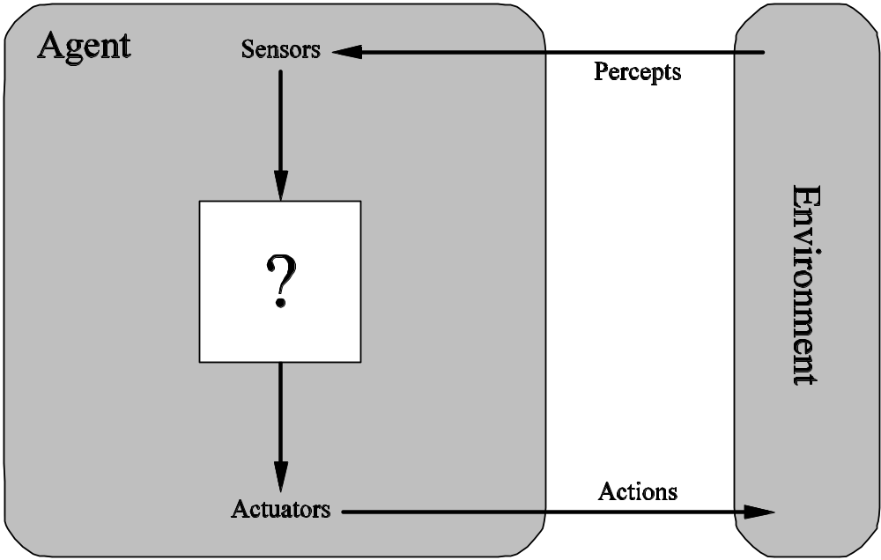
Agents and Environments
CS 362

Slide 4
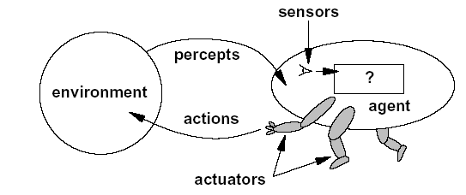
Example 1
A human agent has :
  Sensors: eyes, ears, and other organs.
  Actuator: hands, legs, mouth, and other body part.
A robotic agent might have:
  Sensors: Cameras, infrared range finders ..
  Actuator: motors
A Software Agent
  Sensors: Ks,file
  Contents & n/w Pkts
  Actuator: Disp on Sc.,
  Sending n/w pkts and
  Writing files.
The agent function
maps from percepts histories to actions
F: P→ A
CS 362

Slide 5
Example: Vacuum Cleaner Agent
Agent: robot vacuum cleaner
Environment: floors of your apartment
Sensors:
  dirt sensor: detects when floor in front of robot is dirty
  bump sensor: detects when it has bumped into something
  power sensor: measures amount of power in battery
  bag sensor: amount of space remaining in dirt bag
Effectors:
  motorized wheels
  suction motor
  plug into wall? empty dirt bag?
Percepts: “Floor is dirty”
Actions: “Forward, 0.5 ft/sec”
CS 362

Slide 6
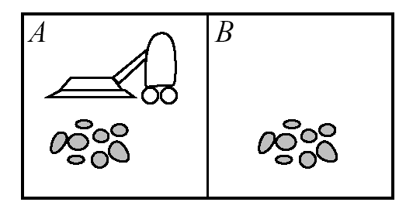

Vacuum Cleaner Agent
CS 362

Slide 7
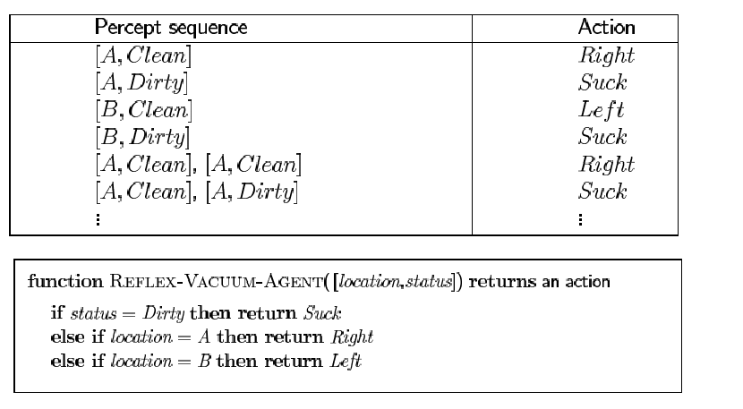
Vacuum Cleaner Agent
CS 362

Slide 8
2.2 Good Behavior: The Concept of Rationality
A rational agent chooses whichever action maximizes the expected value of the performance measure given the percept sequence to date.
Performance Measure: Criteria for determining the quality of an agent’s behavior
  Example: dirt collected in 8 hour shift
CS 362

Slide 9
Omniscience, Learning, and autonomy
An omniscient agent is one that can predict the future perfectly. We don’t want this!
Rational ≠ omniscient
{ percepts may not supply all relevant information
Rational ≠ clairvoyant
{ action outcomes may not be as expected
Hence, rational ≠ successful
Rational = exploration, learning, autonomy
CS 362

Slide 10
Defn: Ideal Rational Agent
For each percept sequence, choose the action that maximizes the expected value of the performance measure given only built-in knowledge and the percept sequence
CS 362

Slide 11
The nature of Environment
To design a rational agent, we must specify the task environment
PEAS Descriptions:
  P: Performance Measure
  E: Environment
  A: Actuators
  S: Sensors
CS 362

Slide 12
Examples of agent types
Agent Type | P | E | A | S
Medical Diagnosis | Healthy patient, minimize costs, lawsuits | Patient, hospital, staff | Display questions, tests, diagnoses, treatments, referrals | Keyboard entry of symptoms, test results, patient’s answers
Satellite image system | Correct image categorization | Downlink from orbiting satellite | Display categorization of scene | Color pixel array
Interactive English tutor | Maximize student’s score on test | Set of students, testing agency | Display exercises, suggestions, corrections | Keyboard entry
CS 362

Slide 13
Examples of agent types
Agent Type | P | E | A | S
Refinery Controller | Maximize Purity,yield, safety | Refinery, Operators | Valves,pumps,heaters, displays | Temperature, pressure, chemical sensors
Booking a railway Ticket ,Planning a Holiday Trip
Taxi Driver | Safe,fast,legal,comfortable trip,maximize profits | Roads,other traffic, pedestrians,customers | Steering,accelator,brake,signal,horn,display | Cameras,speedometer,GPS,odometer,accelerometer,KB,engine sensors.
CS 362

Slide 14
Examples of agent types
Agent Type | P | E | A | S
Refinery Controller | Maximize Purity,yield, safety | Refinery, Operators | Valves,pumps,heaters, displays | Temperature, pressure, chemical sensors
Part picking Robot | Percentage of parts in correct beans | Conveyor belts with parts,bins | Jointed arm and hand | Camera,joint angle sensors.
CS 362

Slide 15
Properties of task Environments
Fully-observable vs. Partially-observable
  If an agent’s sensors give it access to the complete state of the environment at each point in time, then the task is fully-observable. Example: Automated Taxi can not see what other drivers are thinking → Partially observable
Deterministic vs. Stochastic
  If the next state of the environment is completely determined by the current state and the action executed by the agent, then the environment is deterministic. Example: Taxi driving is stochastic.
  Strategic: deterministic except for the actions of other agents
Episodic vs. Sequential
  The agent’s experience is divided into atomic episodes. Each episode consists of the agent perceiving and then performing a single action.
    Classification tasks ?
    Tax and Chess ?
CS 362

Slide 16
Properties of task Environments ..cont.
Static vs. Dynamic
  If the environment can change while an agent is deliberating, then the environment is dynamic.
  Semidynamic: the agent’s performance score changes only.
  Crossword ?
  Taxi is ?
Discrete vs. Continuous
  Chess ?
  Taxi is ?
Single agent vs. Multiagent
CS 362
Notes:
Cooperative or competitive environment. Discrete and continuous variables are two types of quantitative variable:
Discrete variables represent count(e.g. the no. of objects in a collection). Continuous variables represent measureable amounts
(e.g water volume or weight)

Slide 17
Examples of Environments
Environment | Observable | Deterministic | Episodic | Static | Discrete | Agents?
Crossword puzzle | Fully | Deterministic | Sequential | Static | Discrete | Single
Chess w/clock | Fully | Deterministic | Sequential | Semi | Discrete | Multi
Poker | Partially | Strategic | Sequential | Static | Discrete | Multi
Backgammon | Fully | Stochastic | Sequential | Static | Discrete | Multi
Taxi driving | Partially | Stochastic | Sequential | Dynamic | Continuous | Multi
Medical Diag. | Partially | Stochastic | Sequential | Dynamic | Continuous | Single
Image analysis | Fully | Deterministic | Episodic | Semi | Continuous | Single
Part-picking | Partially | Stochastic | Episodic | Dynamic | Continuous | Single
Refinery controller | Partially | Stochastic | Sequential | Dynamic | Continuous | Single
English tutor | Partially | Stochastic | Sequential | Dynamic | Discrete | Multi
CS 362

Slide 18
Agent Functions and Program
An agent is completely specified by the agent function mapping percept sequences to actions
Agent programming: designing and implementing good policies
Policies can be designed and implemented in many ways:
    Tables
    Rules
    Search algorithms
    Learning algorithms
CS 362

Slide 19
Implementing Agents Using Tables
function TABLE‑DRIVEN‑AGENT(percept) returns an action
static: percepts, a sequence, initially empty
table, a table of actions, indexed by percept sequences,
initially fully specified
append percept to the end of percepts
action ← LOOKUP(percepts, table)
return action
Problems:
  Space
  Design difficulty
CS 362
Notes:
Space: For chess this would require 35100 entries
Design difficulty: The designer would have to anticipate how the agent should respond to every possible percept sequence

Slide 20
Avoiding Tables
Compact Representations of the Table.
  Many cells in the table will be identical.
  Irrelevant Percepts.
  Example:
    If the car in front of you slows down, you should apply the brakes.
    The color and model of the car, the music on the radio, the weather, and so on, are all irrelevant.
CS 362

Slide 21
Avoiding Tables (2)
Summarizing the Percept Sequence
  By analyzing the sequence, we can compute a model of the current state of the world.
Percepts
Percept Summarizer
Model
Policy
CS 362

Slide 22
Types of Agent programs
Five basic types to increase generality
  Simple Reflex Agent
  Model-Based Reflex Agents
  Goal-Based Agents
  Utility-Based Agents
  Learning Agents
CS 362

Slide 23
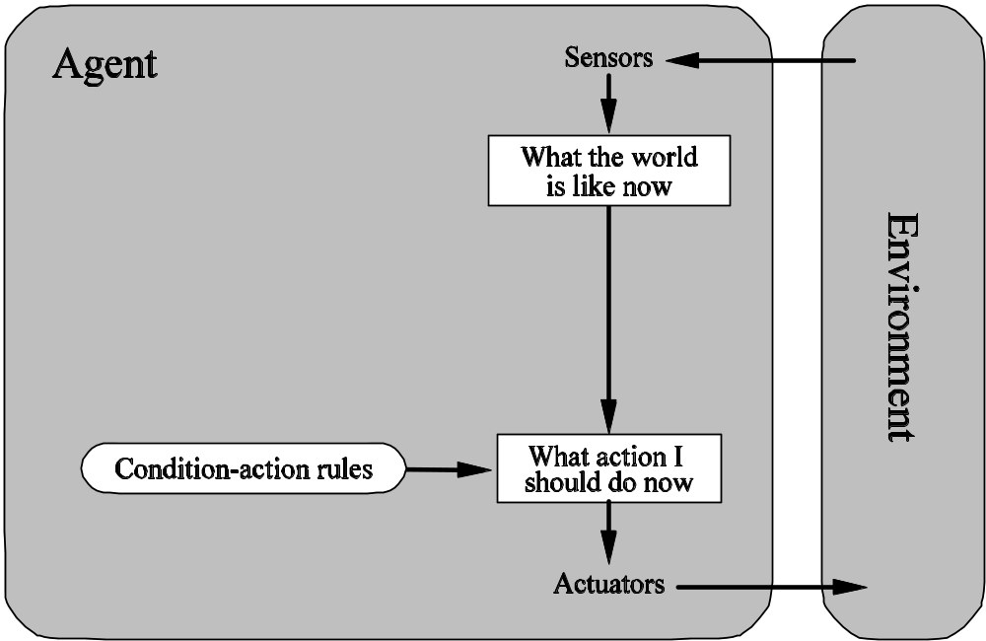
Simple Reflex Agent
Example of Compact Representation: Implementing Agents using Rules
car-in-front-is-braking then initiate-braking
CS 362

Slide 24
Pseudo-Code
function SIMPLE-REFLEX‑AGENT (percept) returns an action
static: rules, a set of condition-action rules
State ← INTERPRET-INPUT(percept)
rule ← RULE-MATCH(state, rules)
action ← RULE-ACTION[rule]
return action
It acts according to a rule whose condition matches the current state, as defined by the percept.
This type is very simple, but:
very limited intelligence
Works only if the environment is fully observable
CS 362

Slide 25
Model-Based Reflex Agents
To handle partial observability
There is an internal state to maintain the percept sequence.
It keeps track of the current state of the world using an internal model. It then chooses an action in the same way as the reflex agent
CS 362

Slide 26
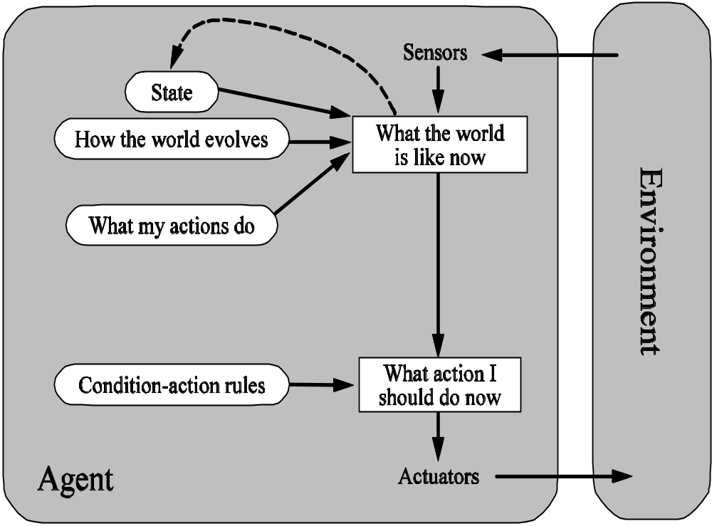
Model-Based Reflex Agents
CS 362

Slide 27
Model-Based Reflex Program
function REFLEX‑AGENT-WITH-STATE(percept) returns an action
static: state, a description of the current world state
rules, a set of condition-action rules
action, the most recent action, initially none
state ← UBDATE-STATE(state, action, percept)
rule ← RULE-MATCH[state, rules]
action ← RULE-ACTION[rule]
return action
CS 362

Slide 28
Goal-Based Agents
The agent needs some sort of goal information that describes situations that are desirable.
  Generate possible sequences of actions
  Predict resulting states
  Assess goals in each resulting state
  Choose an action that will achieve the goal
We can reprogram the agent simply by changing the goals
CS 362

Slide 29
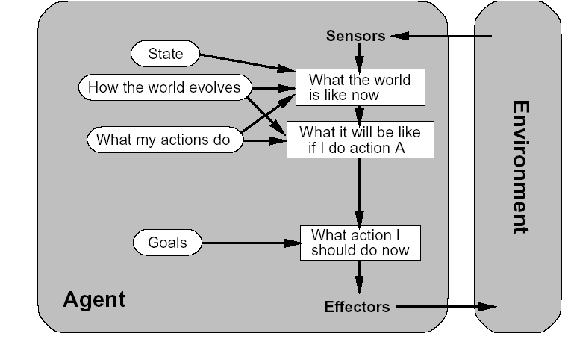
Goal-Based Agents
CS 362

Slide 30
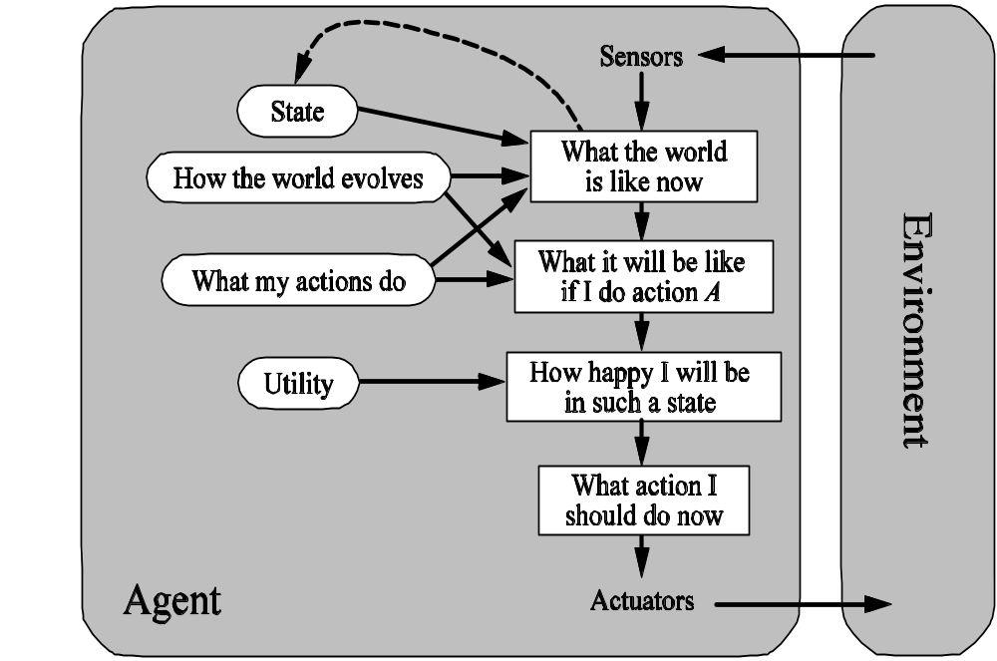
Utility-Based Agents
In some applications, we need to make quantitative comparisons of states based on utilities. Important when there are tradeoffs.
CS 362

Slide 31
Learning Agents
It can be divided into 4 conceptual components:
  Learning elements are responsible for improvements
  Performance elements are responsible for selecting external actions (previous knowledge)
  Critic tells the learning elements how well the agent is doing with respect to a fixed performance standard.
  Problem generator is responsible for suggesting actions that will lead to new and informative experience.
CS 362

Slide 32

Learning Agents
CS 362

Slide 33
Advantages of Simpler Environments
Observable: policy can be based on only most recent percept
Deterministic: predicting effects of actions is easier
Episodic: Do not need to look ahead beyond end of episode
Static: Can afford lots of time to make decisions
Discrete: Reasoning is simpler
CS 362

Slide 34
Summary
Agents interact with environments through actuators and sensors
The agent function describes what the agent does in all circumstances
The performance measure evaluates the environment sequence
A perfectly rational agent maximizes expected performance
Agent programs implement (some) agent functions
PEAS descriptions define task environments
Environments are categorized along several dimensions: observable? deterministic? episodic? static? discrete? single-agent?
Several basic agent architectures exist: reflex, model-based, goal-based, utility-based, learning- based
CS 362

